Slide 1
Algoritm (CSC 206, Autumn’06)
Text (Required):
Introduction to Algorithms
by Cormen, Lieserson, Rivest & Stein
Instructor: Dr. Ali Sabbir
Office Rm 502.
Office Hour:
Sunday & Tuesday: 11 to 12.

Slide 2
Grading
Attendance is required
At least 1 midterm.
Exactly 1 in class Final.
Several quizzes (Announced and Unannounced)
Lots of assignments.

Slide 3
Pre-Requisites
A solid math background.
Some exposure to high level language coding, e.g., C, C++ etc.
Preferred language for this course C++.

Slide 4
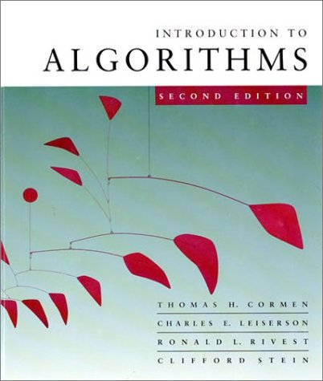
Algorithms
LECTURE 1
Analysis of Algorithms
Insertion sort
Asymptotic analysis
Merge sort
Recurrences

Slide 5
Analysis of algorithms
The theoretical study of computer-program performance and resource usage.
What’s more important than performance?
modularity
correctness
maintainability
functionality
robustness
user-friendliness
programmer time
simplicity
extensibility
reliability

Slide 6
Why study algorithms and performance?
Algorithms help us to understand scalability.
Performance often draws the line between what is feasible and what is impossible.
Algorithmic mathematics provides a language for talking about program behavior.
Performance is the currency of computing.
The lessons of program performance generalize to other computing resources.
Speed is fun!

Slide 7
The problem of sorting
Input: sequence ⟨a₁, a₂, …, a_{n}⟩ of numbers.
Output: permutation ⟨a'₁, a'₂, …, a'_{n}⟩ such
that a'₁ ≤ a'₂ ≤ … ≤ a'_{n} .
Example:
Input: 8 2 4 9 3 6
Output: 2 3 4 6 8 9

Slide 8
Insertion sort
INSERTION-SORT (A, n) ⊳ A[1 . . n]
for j ← 2 to n
do key ← A[ j]
i ← j – 1
while i > 0 and A[i] > key
do A[i+1] ← A[i]
i ← i – 1
A[i+1] = key
“pseudocode”

Slide 9
Insertion sort
INSERTION-SORT (A, n) ⊳ A[1 . . n]
for j ← 2 to n
do key ← A[ j]
i ← j – 1
while i > 0 and A[i] > key
do A[i+1] ← A[i]
i ← i – 1
A[i+1] = key
“pseudocode”
1
i
j
n
A:
key
sorted

Slide 10
Example of insertion sort
8
2
4
9
3
6

Slide 11
Example of insertion sort
8
2
4
9
3
6

Slide 12
Example of insertion sort
8
2
4
9
3
6
2
8
4
9
3
6

Slide 13
Example of insertion sort
8
2
4
9
3
6
2
8
4
9
3
6

Slide 14
Example of insertion sort
8
2
4
9
3
6
2
8
4
9
3
6
2
4
8
9
3
6

Slide 15
Example of insertion sort
8
2
4
9
3
6
2
8
4
9
3
6
2
4
8
9
3
6

Slide 16
Example of insertion sort
8
2
4
9
3
6
2
8
4
9
3
6
2
4
8
9
3
6
2
4
8
9
3
6

Slide 17
Example of insertion sort
8
2
4
9
3
6
2
8
4
9
3
6
2
4
8
9
3
6
2
4
8
9
3
6

Slide 18
Example of insertion sort
8
2
4
9
3
6
2
8
4
9
3
6
2
4
8
9
3
6
2
4
8
9
3
6
2
3
4
8
9
6

Slide 19
Example of insertion sort
8
2
4
9
3
6
2
8
4
9
3
6
2
4
8
9
3
6
2
4
8
9
3
6
2
3
4
8
9
6

Slide 20
Example of insertion sort
8
2
4
9
3
6
2
8
4
9
3
6
2
4
8
9
3
6
2
4
8
9
3
6
2
3
4
8
9
6
2
3
4
6
8
9
done

Slide 21
Running time
The running time depends on the input: an already sorted sequence is easier to sort.
Parameterize the running time by the size of the input, since short sequences are easier to sort than long ones.
Generally, we seek upper bounds on the running time, because everybody likes a guarantee.

Slide 22
Kinds of analyses
Worst-case: (usually)
  T(n) = maximum time of algorithm on any input of size n.
Average-case: (sometimes)
  T(n) = expected time of algorithm over all inputs of size n.
  Need assumption of statistical distribution of inputs.
Best-case: (bogus)
  Cheat with a slow algorithm that works fast on some input.

Slide 23
Machine-independent time
What is insertion sort’s worst-case time?
It depends on the speed of our computer:
  relative speed (on the same machine),
  absolute speed (on different machines).
BIG IDEA:
Ignore machine-dependent constants.
Look at growth of T(n) as n → ∞ .
“Asymptotic Analysis”

Slide 24
Θ-notation
Math:
Θ(g(n)) = { f (n) : there exist positive constants c₁, c₂, and n₀ such that 0 ≤ c₁ g(n) ≤ f (n) ≤ c₂ g(n) for all n ≥ n₀ }
Engineering:
Drop low-order terms; ignore leading constants.
Example: 3n³ + 90n² – 5n + 6046 = Θ(n³)

Slide 25
Asymptotic performance
When n gets large enough, a Θ(n²) algorithm always beats a Θ(n³) algorithm.
We shouldn’t ignore asymptotically slower algorithms, however.
Real-world design situations often call for a careful balancing of engineering objectives.
Asymptotic analysis is a useful tool to help to structure our thinking.
T(n)
n
n₀

Slide 26
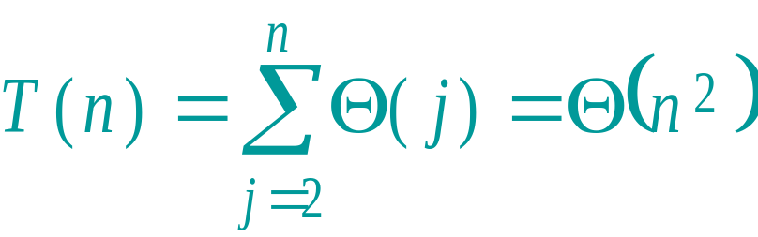
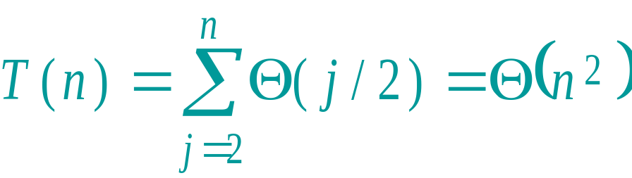
Insertion sort analysis
Worst case: Input reverse sorted.
[arithmetic series]
Average case: All permutations equally likely.
Is insertion sort a fast sorting algorithm?
Moderately so, for small n.
Not at all, for large n.

Slide 27
Merge sort
MERGE-SORT A[1 . . n]
If n = 1, done.
Recursively sort A[ 1 . .⎣n/2⎦ ] and A[.⎣n/2⎦ +1 . . n ] .
“Merge” the 2 sorted lists.
Key subroutine: MERGE

Slide 28
Merging two sorted arrays
20
13
7
2
12
11
9
1

Slide 29
Merging two sorted arrays
20
13
7
2
12
11
9
1
1

Slide 30
Merging two sorted arrays
20
13
7
2
12
11
9
1
20
13
7
2
12
11
9
1

Slide 31
Merging two sorted arrays
20
13
7
2
12
11
9
1
20
13
7
2
12
11
9
1
2

Slide 32
Merging two sorted arrays
20
13
7
2
12
11
9
1
20
13
7
2
12
11
9
20
13
7
12
11
9
1
2

Slide 33
Merging two sorted arrays
20
13
7
2
12
11
9
1
20
13
7
2
12
11
9
20
13
7
12
11
9
1
2
7

Slide 34
Merging two sorted arrays
20
13
7
2
12
11
9
1
20
13
7
2
12
11
9
20
13
7
12
11
9
20
13
12
11
9
1
2
7

Slide 35
Merging two sorted arrays
20
13
7
2
12
11
9
1
20
13
7
2
12
11
9
20
13
7
12
11
9
20
13
12
11
9
1
2
7
9

Slide 36
Merging two sorted arrays
20
13
7
2
12
11
9
1
20
13
7
2
12
11
9
20
13
7
12
11
9
20
13
12
11
9
20
13
12
11
1
2
7
9

Slide 37
Merging two sorted arrays
20
13
7
2
12
11
9
1
20
13
7
2
12
11
9
20
13
7
12
11
9
20
13
12
11
9
20
13
12
11
1
2
7
9
11

Slide 38
Merging two sorted arrays
20
13
7
2
12
11
9
1
20
13
7
2
12
11
9
20
13
7
12
11
9
20
13
12
11
9
20
13
12
11
20
13
12
1
2
7
9
11

Slide 39
Merging two sorted arrays
20
13
7
2
12
11
9
1
20
13
7
2
12
11
9
20
13
7
12
11
9
20
13
12
11
9
20
13
12
11
20
13
12
1
2
7
9
11
12

Slide 40
Merging two sorted arrays
20
13
7
2
12
11
9
1
20
13
7
2
12
11
9
20
13
7
12
11
9
20
13
12
11
9
20
13
12
11
20
13
12
1
2
7
9
11
12
Time = Θ(n) to merge a total of n elements (linear time).

Slide 41
Analyzing merge sort
T(n)
Θ(1)
2T(n/2)
Θ(n)
MERGE-SORT A[1 . . n]
If n = 1, done.
Recursively sort A[ 1 . . ⎡n/2⎤ ] and A[ ⎡n/2⎤+1 . . n ] .
“Merge” the 2 sorted lists
Abuse
Sloppiness: Should be T( ⎡n/2⎤ ) + T( ⎣n/2⎦ ) , but it turns out not to matter asymptotically.

Slide 42
Recurrence for merge sort
Θ(1) if n = 1;
T(n) =
2T(n/2) + Θ(n) if n > 1.
We shall usually omit stating the base case when T(n) = Θ(1) for sufficiently small n, but only when it has no effect on the asymptotic solution to the recurrence.
CLRS and Lecture 2 provide several ways to find a good upper bound on T(n).

Slide 43
Recursion tree
Solve T(n) = 2T(n/2) + cn, where c > 0 is constant.

Slide 44
Recursion tree
Solve T(n) = 2T(n/2) + cn, where c > 0 is constant.
T(n)

Slide 45
Recursion tree
Solve T(n) = 2T(n/2) + cn, where c > 0 is constant.
cn
T(n/2)
T(n/2)

Slide 46
Recursion tree
Solve T(n) = 2T(n/2) + cn, where c > 0 is constant.
cn
cn/2
cn/2
T(n/4)
T(n/4)
T(n/4)
T(n/4)

Slide 47
Recursion tree
Solve T(n) = 2T(n/2) + cn, where c > 0 is constant.
cn
cn/2
cn/2
cn/4
cn/4
cn/4
cn/4
…
Θ(1)

Slide 48
Recursion tree
Solve T(n) = 2T(n/2) + cn, where c > 0 is constant.
cn
cn/2
cn/2
h = lg n
cn/4
cn/4
cn/4
cn/4
…
Θ(1)

Slide 49
Recursion tree
Solve T(n) = 2T(n/2) + cn, where c > 0 is constant.
cn
cn
cn/2
cn/2
h = lg n
cn/4
cn/4
cn/4
cn/4
…
Θ(1)

Slide 50
Recursion tree
Solve T(n) = 2T(n/2) + cn, where c > 0 is constant.
cn
cn
cn/2
cn/2
cn
h = lg n
cn/4
cn/4
cn/4
cn/4
…
Θ(1)

Slide 51
Recursion tree
Solve T(n) = 2T(n/2) + cn, where c > 0 is constant.
cn
cn
cn/2
cn/2
cn
h = lg n
cn/4
cn/4
cn/4
cn/4
cn
…
…
Θ(1)

Slide 52
Recursion tree
Solve T(n) = 2T(n/2) + cn, where c > 0 is constant.
cn
cn
cn/2
cn/2
cn
h = lg n
cn/4
cn/4
cn/4
cn/4
cn
…
…
Θ(1)
#leaves = n
Θ(n)

Slide 53
Recursion tree
Solve T(n) = 2T(n/2) + cn, where c > 0 is constant.
cn
cn
cn/2
cn/2
cn
h = lg n
cn/4
cn/4
cn/4
cn/4
cn
…
…
Θ(1)
#leaves = n
Θ(n)
Total = Θ(n lg n)

Slide 54
Conclusions
Θ(n lg n) grows more slowly than Θ(n²).
Therefore, merge sort asymptotically beats insertion sort in the worst case.
In practice, merge sort beats insertion sort for n > 30 or so.
Go test it out for yourself!

